Slide 1
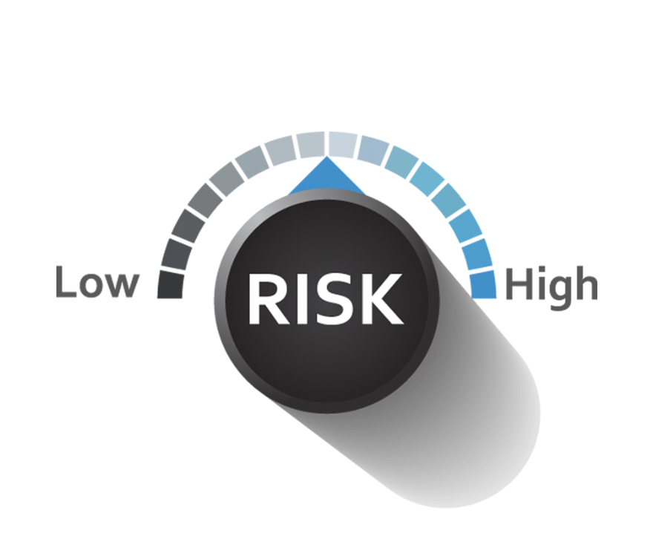
Credit Risk Analysis

Slide 2
KPI Indicator For Different Parameter
Average Default Rate Based on Loan Grade:
D Grade: Highest default rate at 2138.
G Grade: Lowest default rate at 63.
Insight: There’s a significant correlation between loan grade and default rate. Higher-grade loans (G) show a lower default risk, while lower-grade loans (D) carry a much higher default risk.
Average Interest Rate Based on Loan Grade:
B Grade: Highest interest rate at 102,654.95.
G Grade: Lowest interest rate at 1,194.84.
Insight: Higher-grade loans have much higher interest rates, possibly indicating higher-risk lending, whereas lower-grade loans have significantly lower interest rates.
Average Loan Amount Based on Loan Grade:
B Grade: Highest loan amount at 103,643,275.
G Grade: Lowest loan amount at 1,100,525.
Insight: Higher loan amounts are associated with higher loan grades (B), while lower-grade loans have much smaller amounts, showing more conservative lending for higher-risk borrowers.

Slide 3
Home Status-wise Loan Default Rates:
Highest Default Rate: Rent (34.55% of loans, 15.97% default rate).
Lowest Default Rate: Own (7.31% of loans, 0.59% default rate).
Insight: Renting borrowers show a higher risk of default, while owning a home correlates with a lower default rate, suggesting that home ownership is linked to more financial stability.
Customer Working Years vs Loan Default Status:
Most Defaults: Customers in the 1-5 years working age have the highest default rates.
Lowest Defaults: Customers with more than 20 years of work experience show almost 0% default rate.
Insight: Loan defaults are higher among borrowers in their early career stages (1-5 years), while default rates decrease significantly with increased work experience.

Slide 4
Loan Amount and Annual Income Relationship
Highest Annual Income & Loan Amount: Home improvement (annual income 73.48K, loan amount 10.35K).
Lowest Annual Income & Loan Amount: Medical (annual income 61.34K, loan amount 9.26K).
Insight: Borrowers with higher annual income tend to take out larger loans, with home improvement loans being the highest in both income and loan amount.
Loan Amount to Annual Income Ratio:
Highest Ratio: Medical and Education (both at 0.15).
Lowest Ratio: Debt consolidation, Venture, Personal, and Home improvement (all at 0.14).
Insight: Medical and education loans have the highest loan-to-income ratio, indicating higher borrowing relative to income in these categories.

Slide 5
Loan Default Rate Based on Loan Years:
Highest Default Rate: 0-5 years (19.81%).
Lowest Default Rate: 20-30 years (less than 0.5%).
Insight: Loan defaults are significantly higher in the early years of the loan, especially within the first 5 years, but drop drastically for longer loan durations (20+ years).
Default Rate vs Interest Rate Comparison:
Default Rate: 3.085E-5 (extremely low).
Interest Rate Range: 0% to 23%.
Insight: Default rates are negligible compared to interest rates, indicating that interest rates, even at their highest, do not strongly correlate with default risk.

Slide 6
Loan Default Rate by Loan Purpose:
Highest Default Rate: Medical (22.81%).
Lowest Default Rate: Venture (11.91%).
Insight: Medical loans have the highest default rate, followed by debt consolidation, while venture loans have the lowest default rate, suggesting differing risk levels based on loan purpose.

Slide 7
Risk Score and Multiple Data Insights:
Lowest Risk Score (6):
Total Annual Income: 697,496K.
Total Loan Amount: 93,368K.
Average Working Years: 9.
Historical Defaults: 9,434.
Highest Risk Score (11):
Total Annual Income: 5,189K.
Total Loan Amount: 1,310K.
Average Working Years: 0.
Historical Defaults: 41.
Insight: Lower risk scores are linked to higher income, more working years, and fewer historical defaults, while higher risk scores correspond to lower income, fewer working years, and more historical defaults.

